Slide 1


Slide 2
DATA SCIENCE WITH PYTHON

Slide 3
DATA SCIENCE
Data Science is a deep study of the massive amount of data, which involves extracting meaningful insights from the raw, structured and unstructured data.
These data is processed with the using of scientific metods, different algorithms and technologies.

Slide 4
Pythonic Auto-Login: Buliding a Bot in Minutes

Slide 5
CONTENT
What is an Auto-login bot ?
Why python?
Building the bot
Testing and Troubleshooting
Conclusion

Slide 6
INTRODUCTION
Welcome to this presentation on building a simple auto-login bot using Python!
In today's digital age, we are all overwhelmed by the sheer number of online accounts we have. It can be difficult to keep track of all our login credentials, especially if we use different usernames and passwords for each account. This is where an auto-login bot comes in handy. An auto-login bot automates the process of logging into websites, saving you time and frustration. In this presentation, we will explore how to build such a bot using Python.

Slide 7
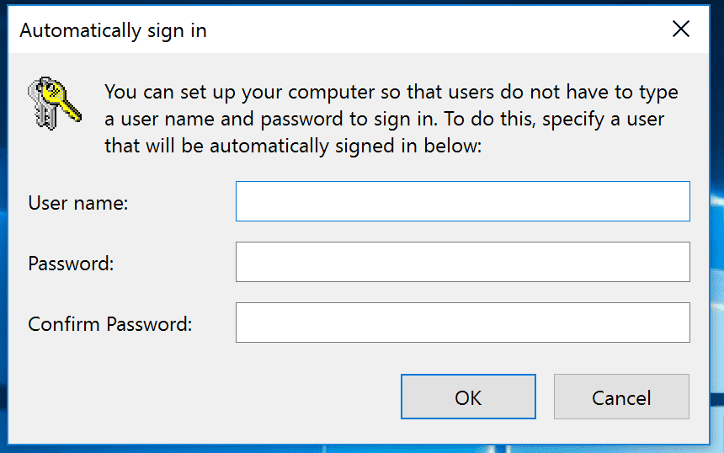
What is an auto-login bot?
An Auto-login bot is a program that automates the login process for a web site or application.
Auto-login bots are useful because they save time and effort for users who need to access multiple accounts regularly.
An Auto-login eliminates the manual login each time.
These Auto-login bots can also perform other tasks such as filling forms, clicking buttons and navigating through pages to complete a specific task.

Slide 8

WHY PYTHON
Python is a high-level, object-oriented, interpreted Language.
Python works in various sector like Machine Learning, Artificial Intelligence.
Python is an ideal –language for building auto-login bots due to its simplicity and versatility.
Its clean syntax and ease of use make it a popular choice among developers of all levels.
One of the key advantage of using Python for building auto-login bots is its extensive library of modules and packages.
These pre-built tools can save developers significant time and effort,allowing them to focus on the core functionality of their bot.

Slide 9
Building The Bot
To build the auto-login bot, we will use the python’s Selenium library.
Selenium is a powerful tool for automating web browsers and can be used for a variety of tasks.
To use the Selenium library, first we need to install the selenium module with the help of the command “pip install selenium” in the command prompt or terminal.
Then, we will need to download the appropriate web driver for the browserwe want to automate.

Slide 10
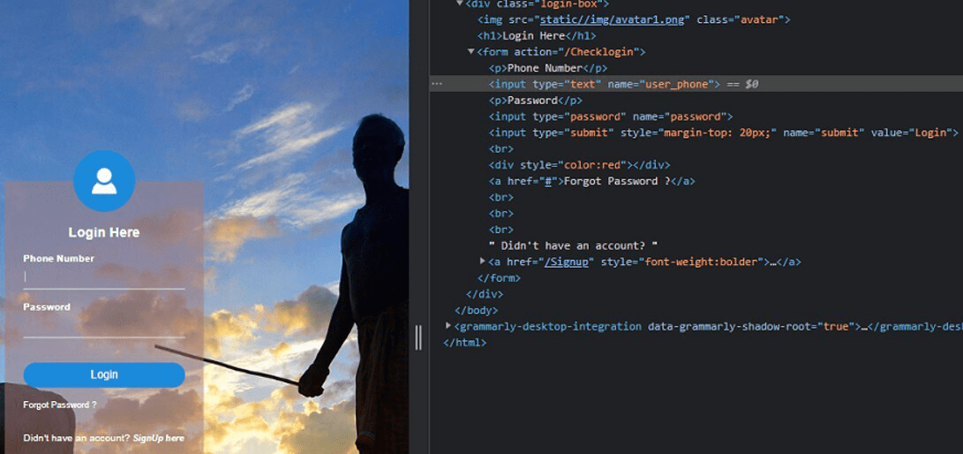
Once we have downloaded the driver, we can add it to our system PATH
So that PYTHON can find it.

Slide 11
Testing and Troubleshooting
Once you have built your auto-login bot using the python, it is important to test and trouble shoot it before deploying in the production environment.
One way to do this by running the bot on a test website or application that stimulates the login process.
This will help you in identifying the errors and bugs in the code.

Slide 12

Another important aspect to testing and troubleshooting is logging.
By logging key events and actions taken by the bot, you can easily track down errors and identity areas where the code can be optimized.

Slide 13
CONCLUSION
In conclusion ,we have learned the basics of building a simple auto-login bot using PYTHON.
We defined what an auto-login bot is and explained why it is useful.
We created a Auto-Login Bot using the Python built-in library ‘selenium’-library.
Then we defined how to test and troubleshoot the login bot.
Remember to keep practicng and experimenting with different techniques to improve your skills!.

Slide 14


